Slide 1
RI Theme 2023-24

Slide 4
Wi-Fi -- BPOE1903
Password - BPOE1903

Slide 5
Welcome to
District 7630 Membership Summit
September 23, 2023
Notes:
Hugh
Ask everyone to use their cell phones to take a selfie with who is sitting next to them.
Also, during the break please take some more pictures of make a short video with someone attending today.
More to come on this later in the day….

Slide 6
Why are we here &
what will you take away
Hugh Dawkins
Zone 33 Assistant Rotary Coordinator
Notes:
Ask Guests for input before going to next slide
Get out phone & take a selfie with who is sitting next to you.
Also during the break take a few selfies with others. More to come on this topic…
Know the history of your club
Plan for Moderate Club Growth
How to attract & keep members
New MAP System
Where can I find HELP
How PI & RI Foundation are a part of Moderate Membership Growth

Slide 7
Know the history of your club
Plan for Moderate Club Growth
How to attract & keep members
New MAP System
Where can I find HELP
How PI & RI Foundation are a part of Moderate Membership Growth
Notes:
Comment on each topic very BRIEF

Slide 9
Know Your Club’s History So You Can Plan for Success
District 7630 Membership Summit
Dover Elks Club
September 23, 2023
District Membership Chair, Gary King

Slide 10
Club experience is the number one reason people join Rotary.
They seek community service opportunities
They want fellowship with like-minded people
They are looking to build business relationships

Slide 11
Club experience is the number one reason people leave Rotary.
They don’t feel welcome.
They find the meetings uninteresting.
Their reason for attending is not worth their time.
15% of members leave clubs annually.

Slide 12
Research shows it is easier to keep the members you have than attract new members.
Retention is the key to keeping your club healthy.
Enhanced engagement through a positive club experience.
What is interesting to your members?
Club survey.

Slide 13
Use club data to monitor members’ interest.
Attendance.
Ask your members for their input, ideas.
Monitor their involvement with projects.
Reach out to those uninvolved.
Gender and ethnic balance.
Does the club reflect the community it serves?

Slide 14
What is your Club’s culture?
Legacy club with established meeting format.
Action club with younger members doing projects.
Set agenda in a closed environment.
Special interest club.
Interaction among membership.
Planning projects during meetings.
Meeting time, meals, expense.

Slide 15
Changing your club’s culture to engage current members while attracting new members.
Keep it fresh.
Change is good.
Solicit ideas from the membership.
Offer time for members to interact with each other.
Approach the old guard for their concerns.
Target those reluctant members to get them on board.

Slide 16
Membership Action Plan (MAP) as a key to knowing your club and setting goals.
MAP Dashboard.
Current membership.
Attrition rate.
Attraction rate.
Plan for growth.
Know where you are to plan where you want to go.

Slide 17
Know where you are to plan where you want to go.
Would you consider becoming an innovative club.
Special Interest club.
Project only club.
Impact club.
Host to a satellite club.
Allow new ideas to flourish.

Slide 18
Thank you for your open minds to new membership engagement approaches.

Slide 19
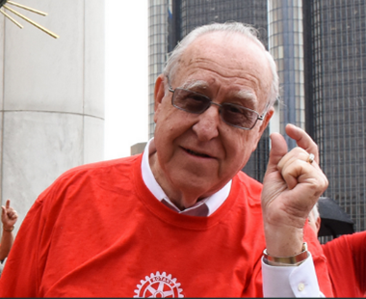

Slide 20
What is MAP &
How to use it
IPDG Cliff Berg
District MAP Ambassador

Slide 21
Membership Action Plan Webinars Zones 33 & 34

Slide 22
Series of Monthly Webinars
Exchange of Ideas & Best Practices
Club Membership Chairs & Club Leadership
Second Monday of Month – 6:00 P.M.
Register on DACdb
Next Webinar – October 9th
All Webinars Available for Viewing on Zone 33-34 Website

Slide 23
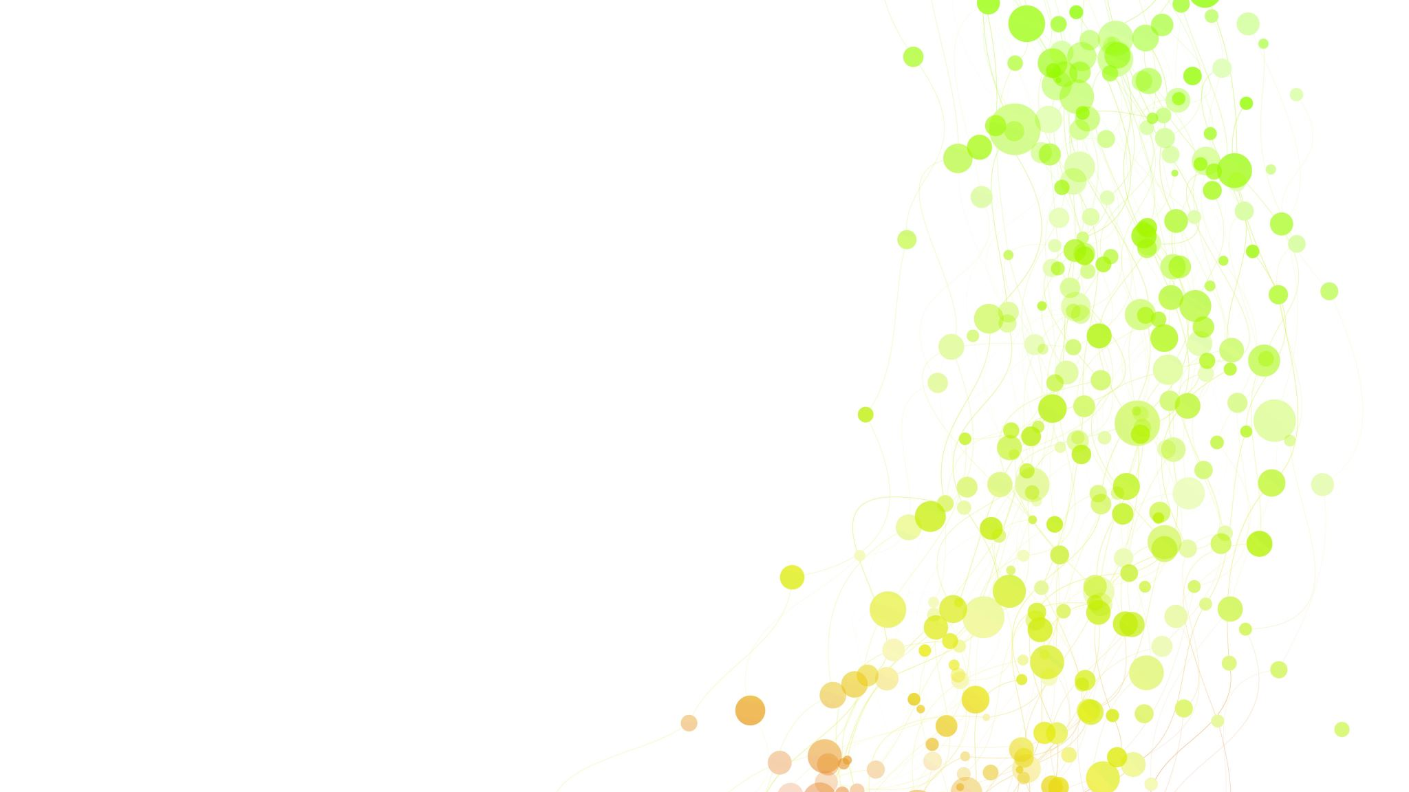
Membership Success Center

Slide 24
Located on DACdb – District – Membership Success Center Icon
Video Guided Tours
Membership Goal
Progress Dashboard
Surveys
Notes:
Review how to retrieve Icon if doesn’t appear
Goals do not automatically go to Rotary Club Central & visa versa
goal setting step by step and accounts for attrition
Handout of sample survey questions in a few minutes

Slide 25
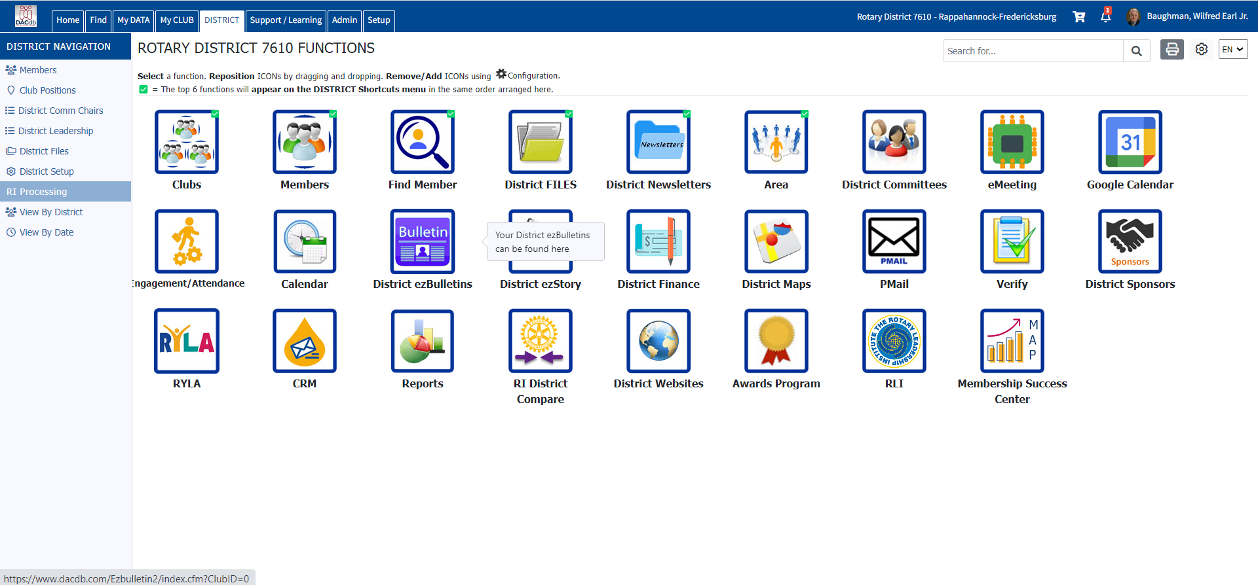

Slide 26
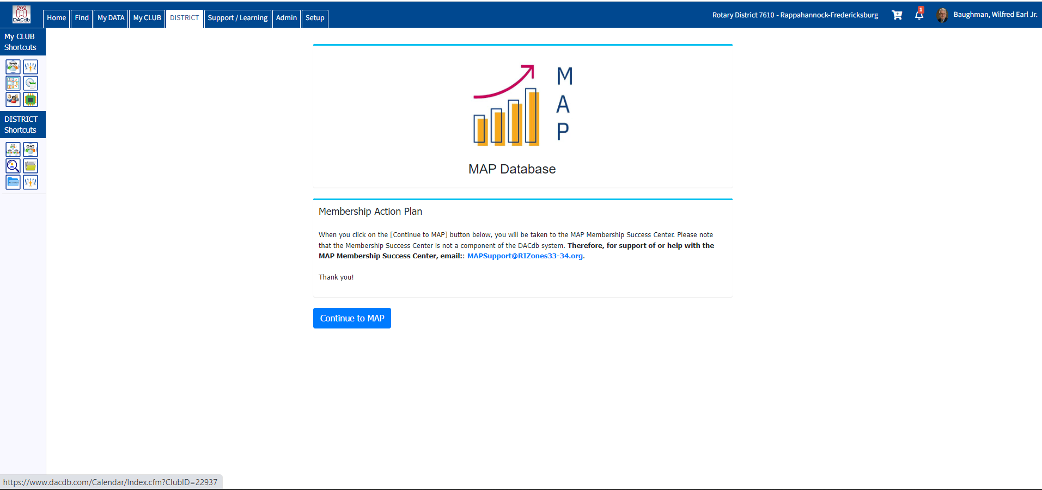

Slide 28
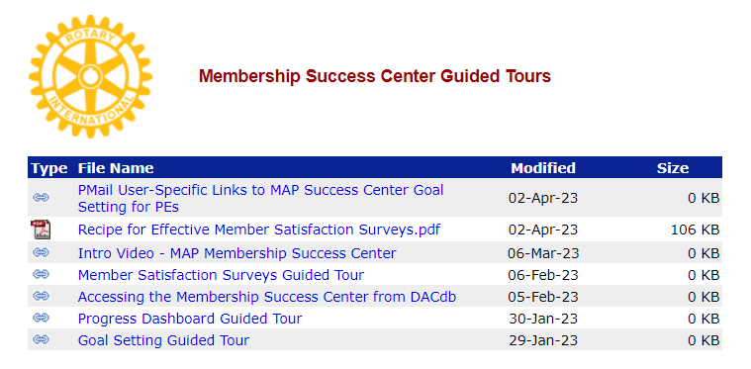

Slide 29
Break –
15 minutes

Slide 30
A Successful Membership Plan
Hugh Dawkins
Zone 33 Assistant Rotary Coordinator

Slide 31
Why do I want to grow my club?
How do I make my new member feel welcome & engaged in the club?
We will look at the 5 parts in a successful Membership Plan
Notes:
Discuss your community’s needs and develop creative ways to meet them
Connect with other leaders who are changing the world
Expand your leadership and professional skills
Catch up with good friends and meet new ones
Get involved in ways that align with your passions, and you’ll get much more from your experience.
Hope is NOT a strategy
Rotary is a “Membership Organization”
Members are our customers
Without members, how will we deliver service?
“Who Do You Know?”
Dedicated club assembly just for this exercise
How many contacts do you have in your Smart Phone?
Now multiply this times all members in your club
How many potential members identified?
SHARE YOUR IDEAS FIND A MENTOR ORGANIZE A CLUB EVENT TRY A NEW ROLE BECOME A LEADER IN ACTION
VOLUNTEER TO HELP BRIDGE GENERATIONS CREATE STRONGER COMMUNITY TIES PARTICIPATE IN TRAINING EVENTS COLLABORATE WITH OTHER CLUBS
MEET OTHER MEMBERS PARTICIPATE IN INTERNATIONAL PROJECTS HELP ERADICATE POLIO ATTEND ROTARY EVENTS SHARE INTERNATIONAL HOSPITALITY SUPPORT ROTARY’S CURRENT WORK JOIN ROTARY DISCUSSION GROUPS SHARE YOUR EXPERTISE

Slide 32
DISCOVER ROTARY
Paul Keely
Membership Chair
Newark Morning Rotary

Slide 33
Welcome Guests
Newark Morning Rotary
Discover Rotary Hour
September 23, 2023

Slide 34
What is Rotary?
It’s busy people,
just like you and me,
working to make life just a little bit better
for others here at home, and around the world.

Slide 35
Rotary is ...
Clean drinking water for people …
Vaccinations for millions of children …
Schools and books for children …
Health care for mothers and babies …
Peace and conflict resolution in communities …
Food on the table of families …
Good stewardship for our global neighbors …
… that we’ll never meet.

Slide 36
Rotary In the World

Slide 37
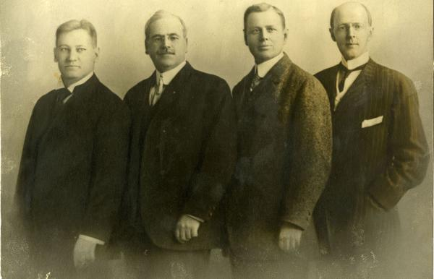
Our History – Paul Harris
Founded 1905 in Chicago
by Paul Harris (& friends)
Rotated meetings among member’s locations
1st project: Public Toilets

Slide 38
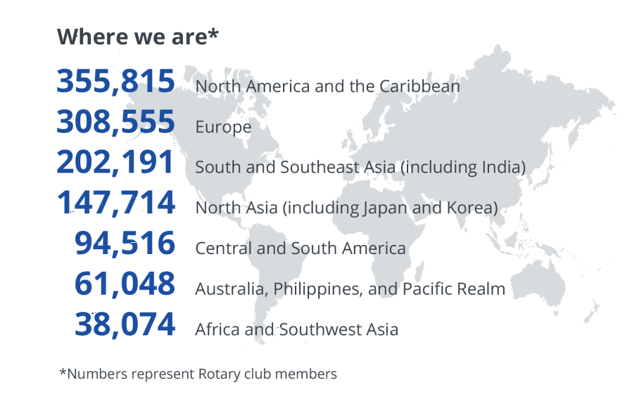
Our History – Rotary Today
1.2 million members
36,000 global clubs
nearly 200 countries
Notes:
38

Slide 39
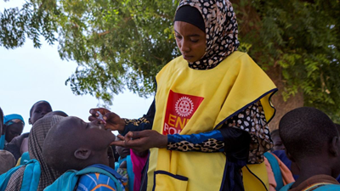
Our History – Polio Eradication
Working to eradicate Polio for over 30 years
1985: 1,000 cases per day (350,000 per year)
NOW: 30 cases in 2022

Slide 40
Our History - The Rotary Foundation
Rotary’s philanthropic arm
Started in 1917 with $26.50
Highest rating (4-stars) by Charity Navigator
Spent over $4 billion on life-changing projects

Slide 41
Our History – The Four Way Test

Slide 42
Newark Morning Rotary

Slide 43
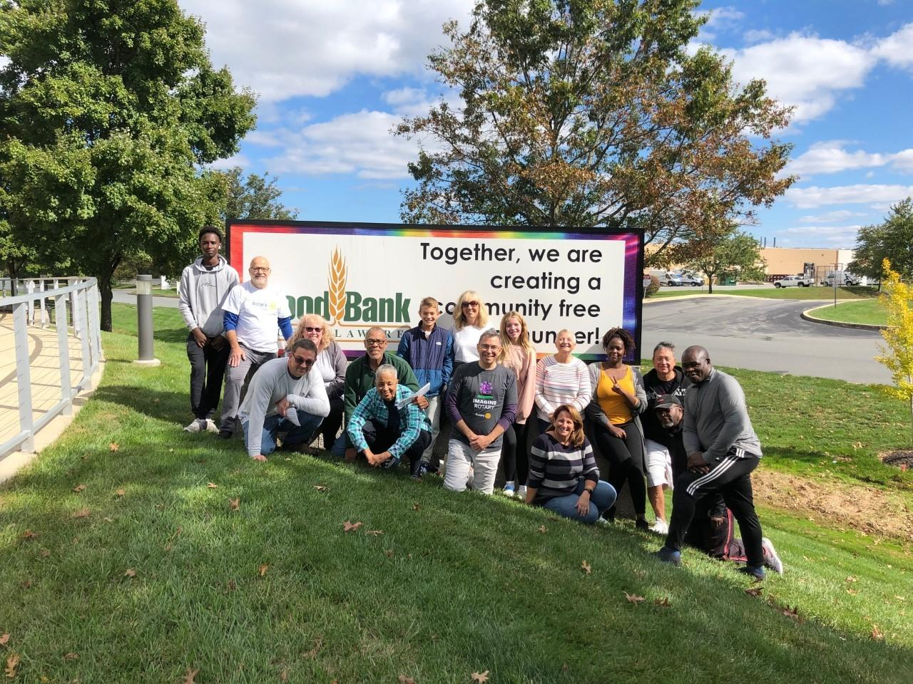
Newark Morning Rotary
Celebrated 24rd Anniversary in 2023
45 members of varied interests and professions
Meet weekly on Thursdays from 7:00am - 8:15am

Slide 44
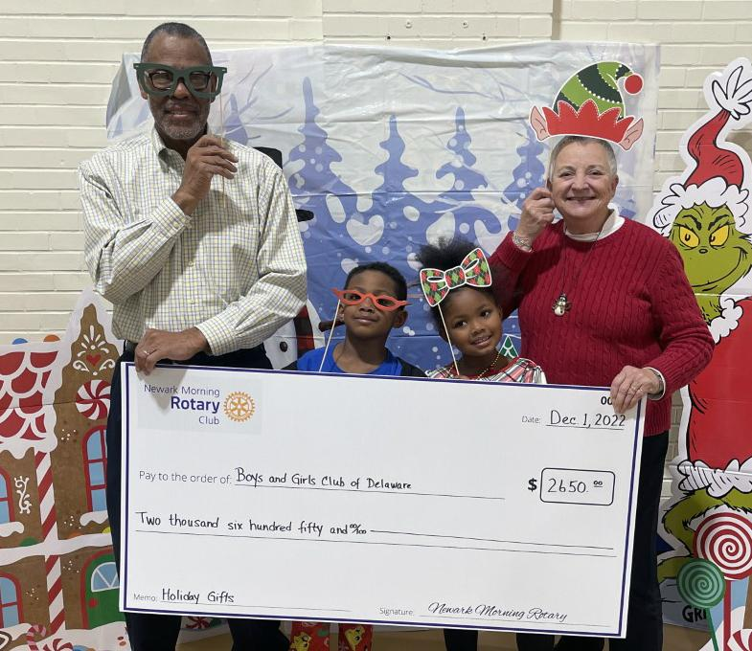
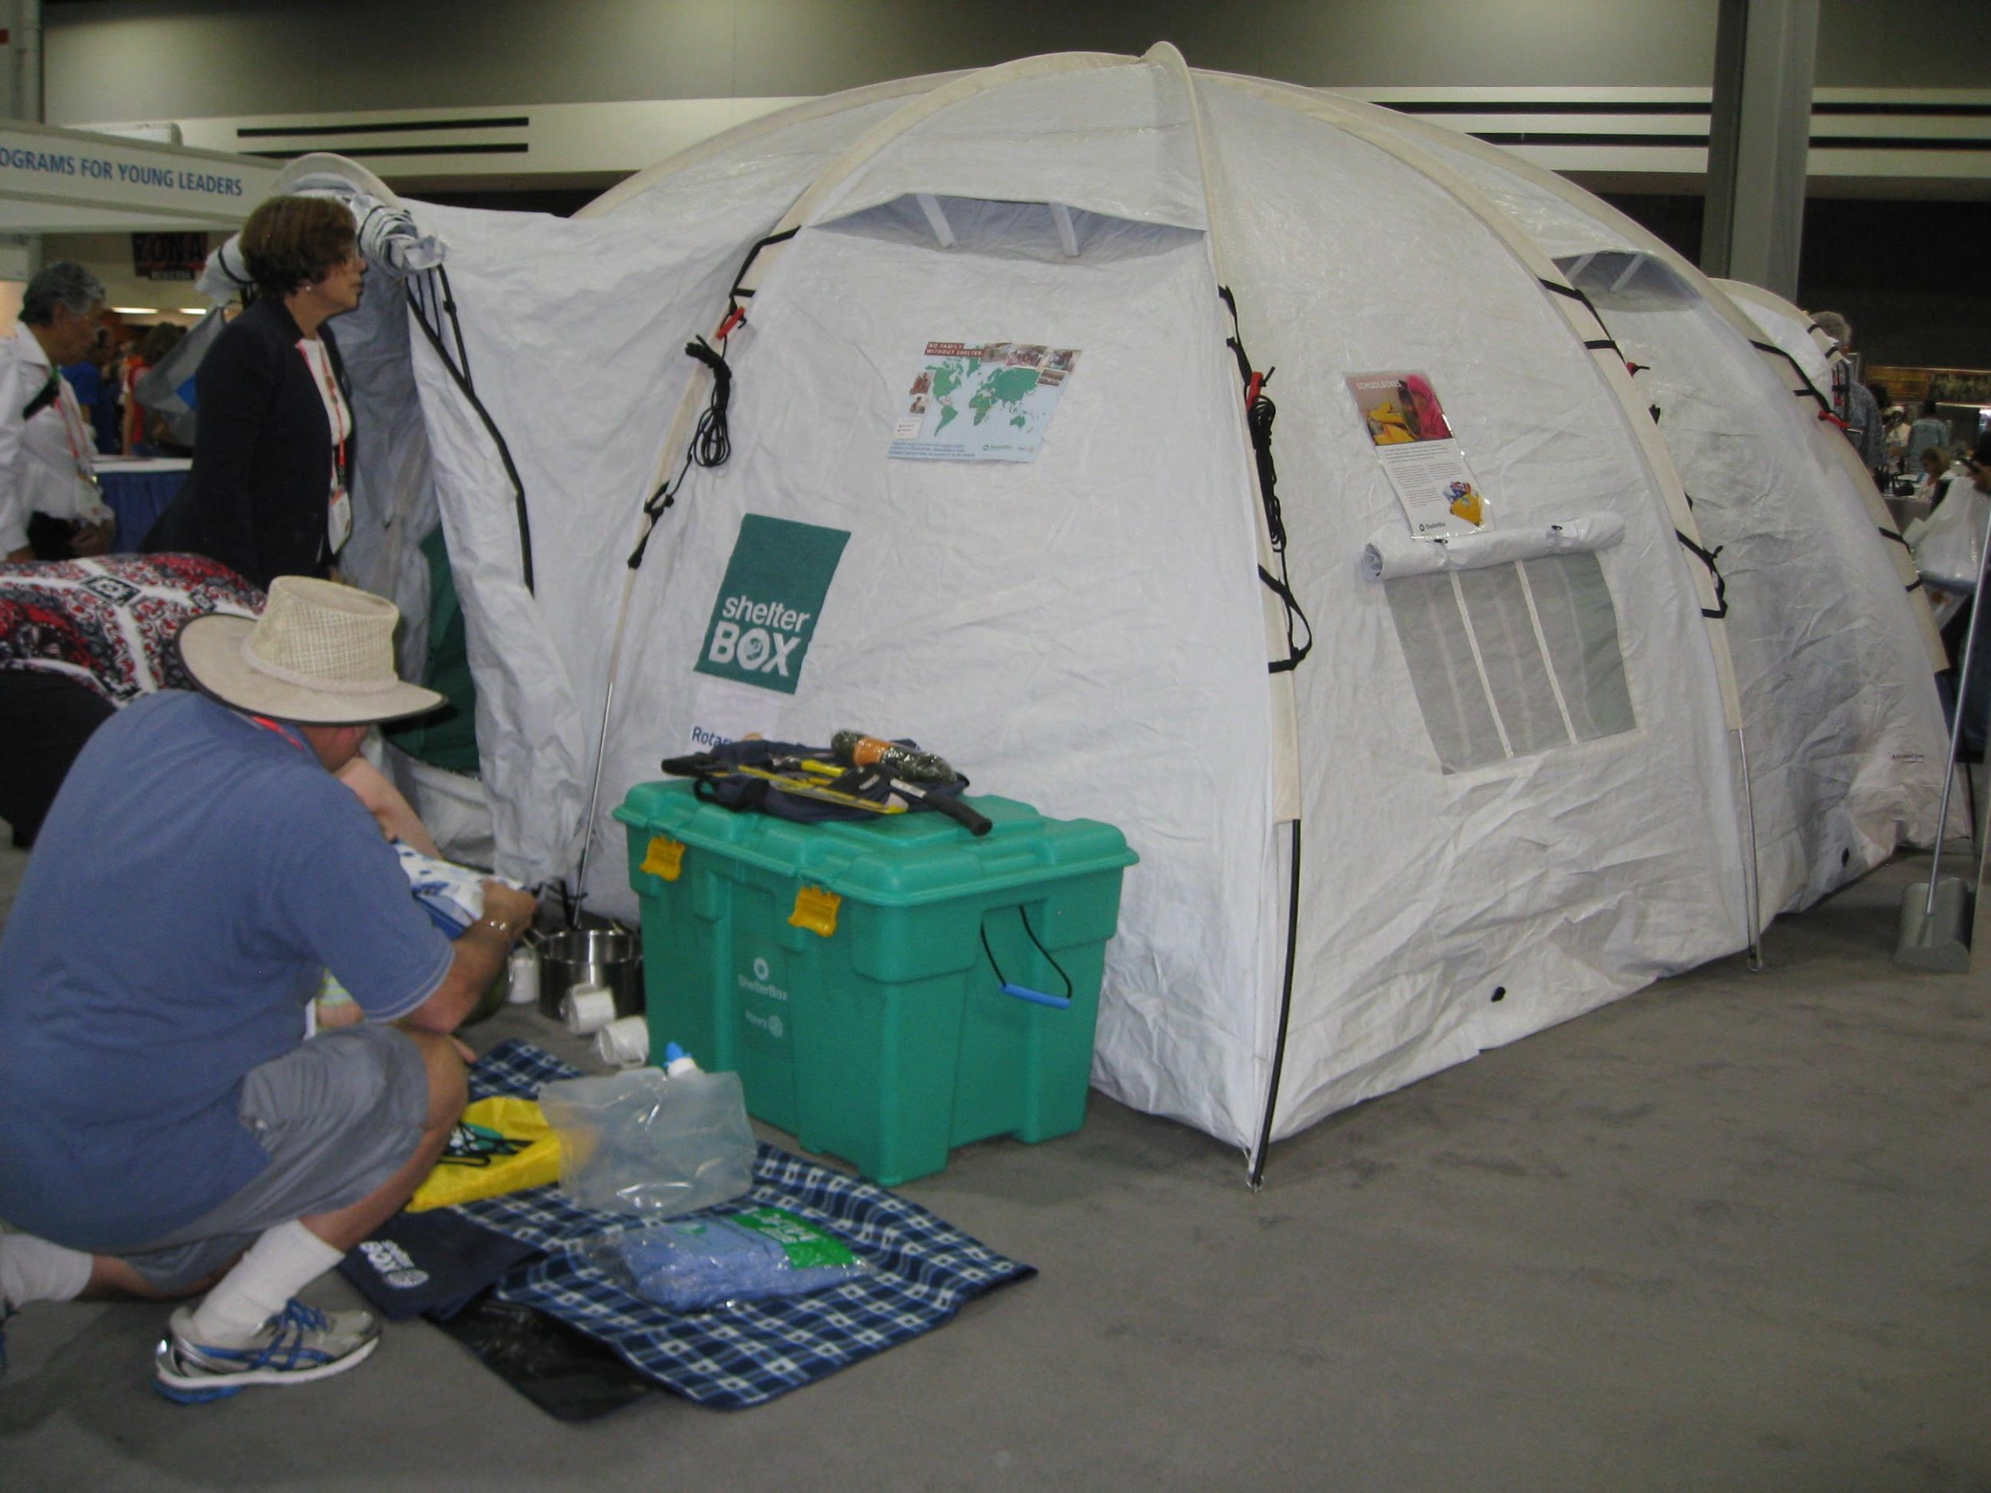
Dedicated to Serving the Community
We give money when vital …

Slide 45
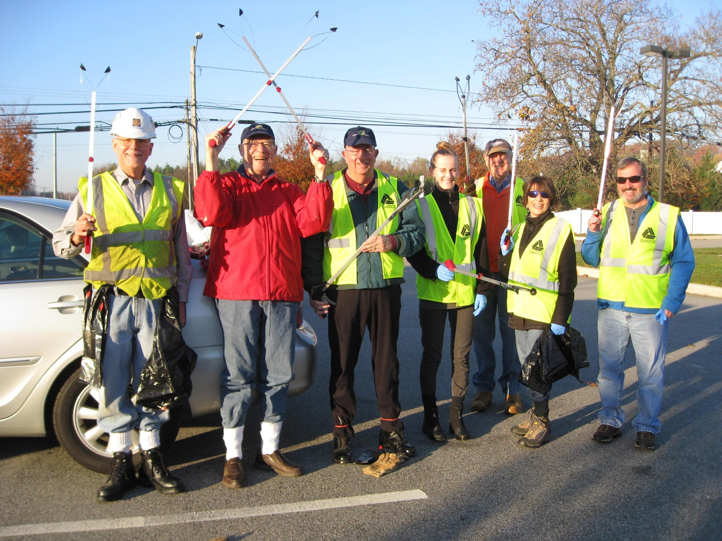
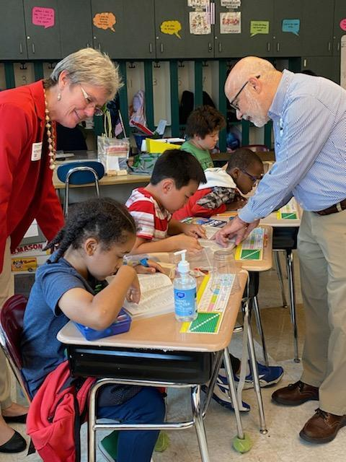
… and time when we can

Slide 46
Report To Our Community
One HUGE fundraiser per year; Report To Our Community
Nearly $750,000 raised for community service projects
Money spent on humanitarian projects: Locally, Regionally, Globally
Not One Penny spent on ourselves

Slide 47
No raffle tickets, pizza kits, or bake sales

Slide 48
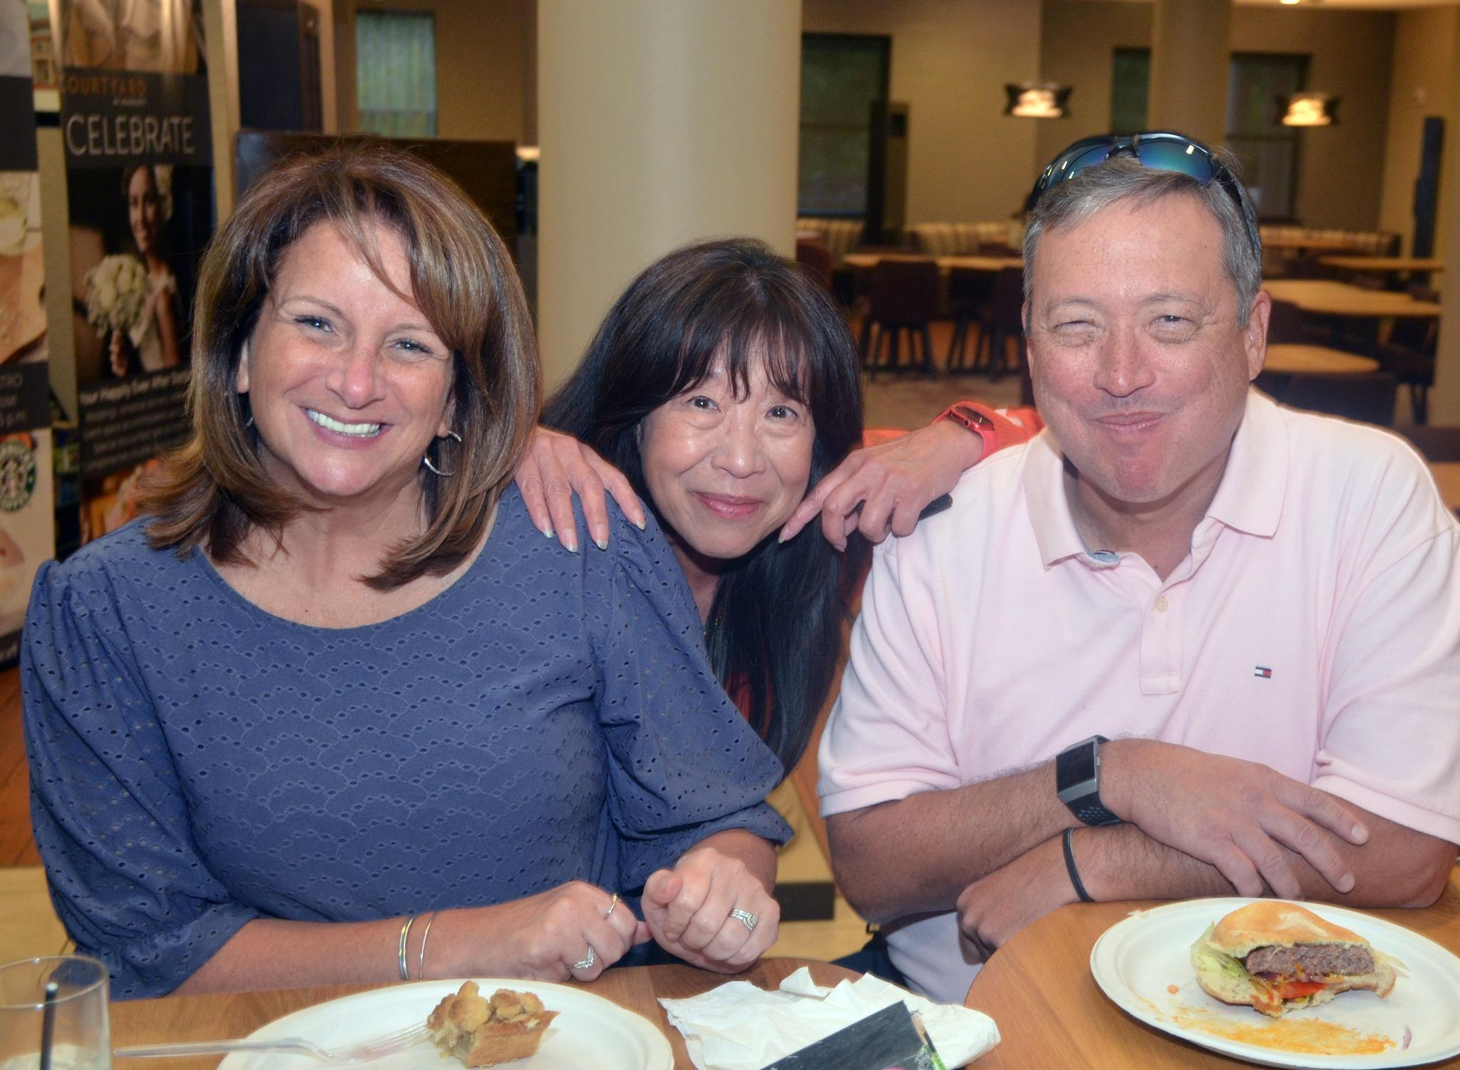
Newark Morning Rotary
Who are we at Newark Morning Rotary?
Men and Women, Ages 30 to 80
Working and Retired
45+ Members: Variety of Professions and Interests

Slide 49
We’re just like you …
Education
Engineering
Law
Real Estate
Financial Planning
Accounting
Business Owners
Clergy
Media
Elected Officials
Non-Profit
Hospitality
Communications
Retired
and more ...

Slide 50
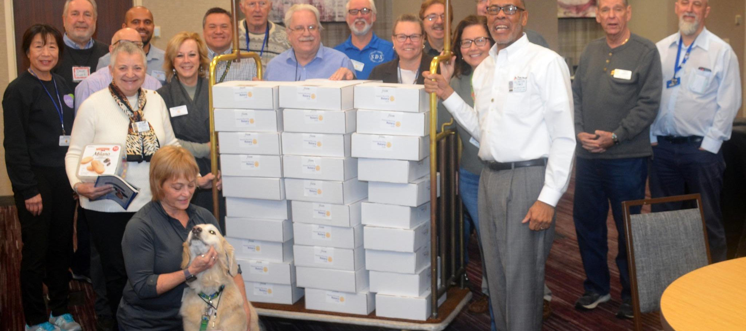
Newark Morning Rotary

Slide 51
Is This for Me?
Notes:
51

Slide 52
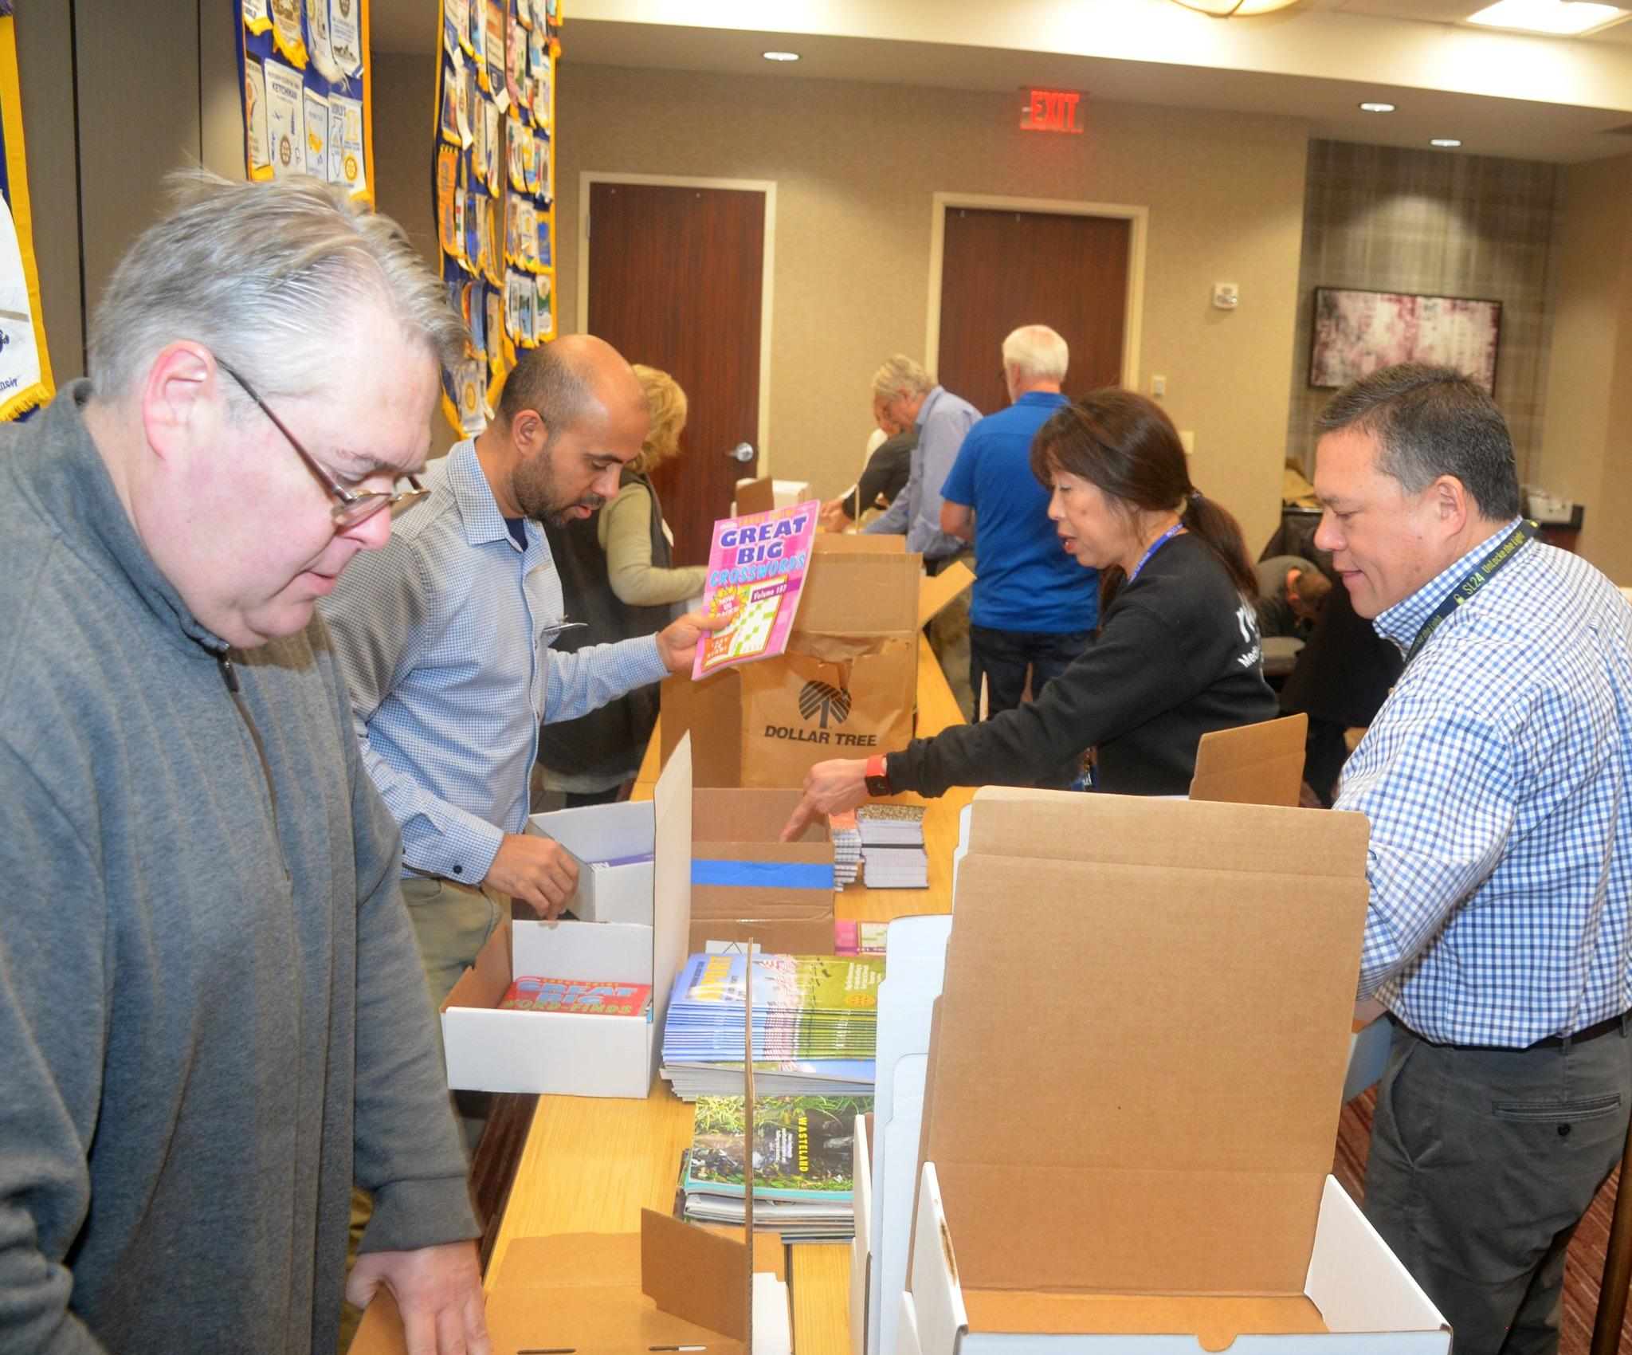
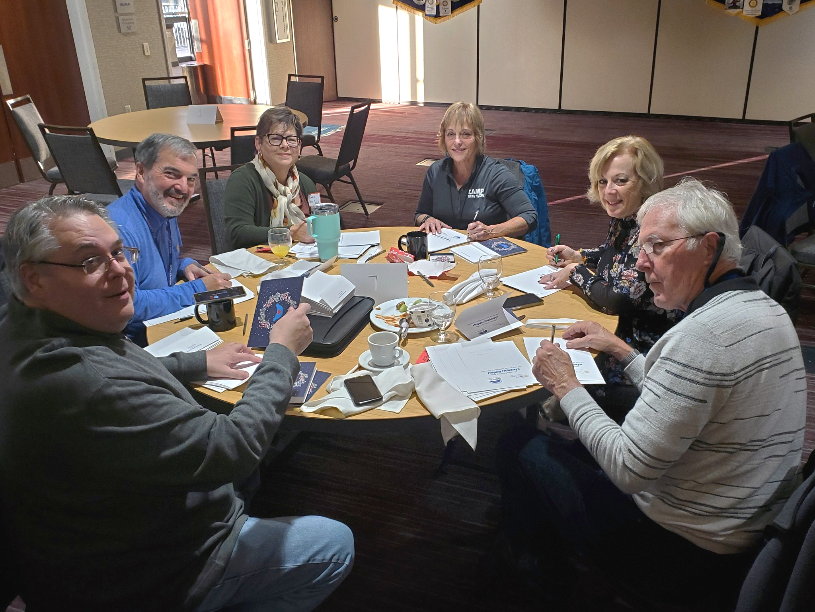
Is This for Me?
Thursday mornings
7:00 am to 8:15 am
Come dressed as you would for work
Notes:
52

Slide 53
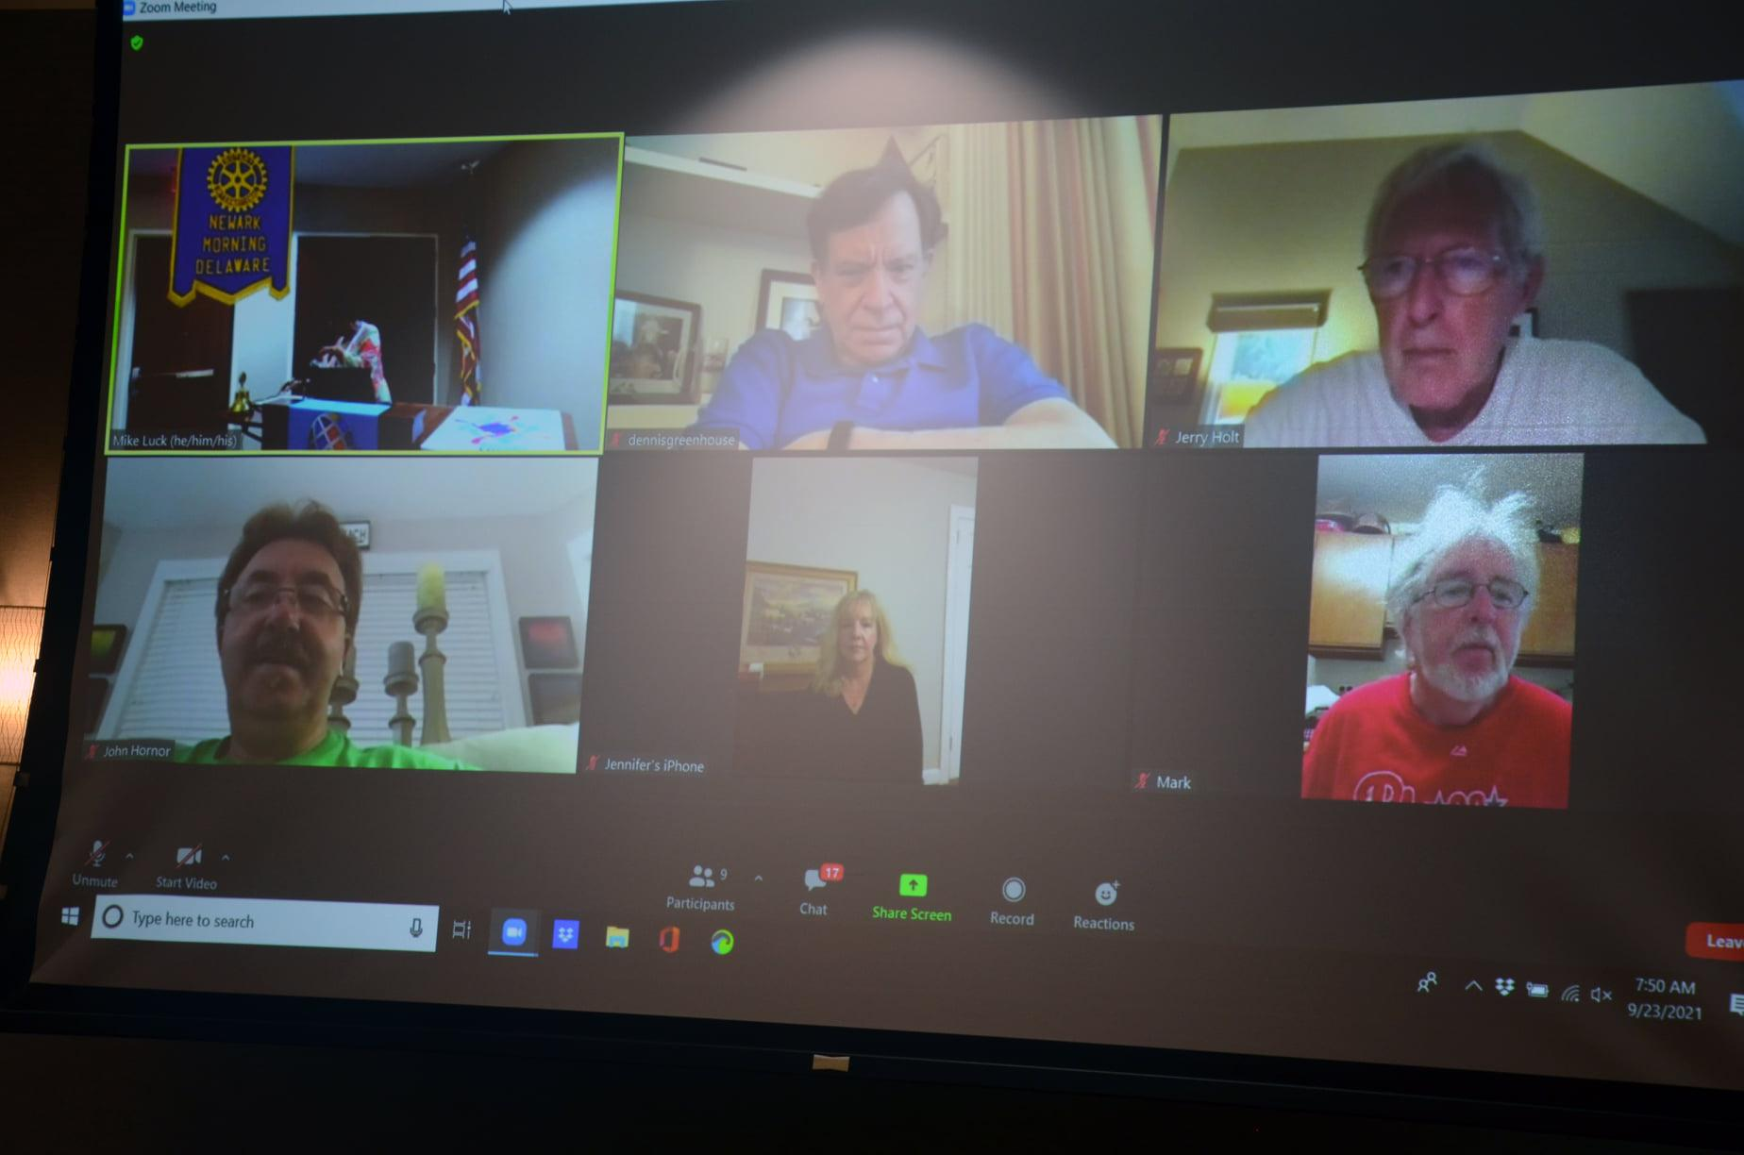
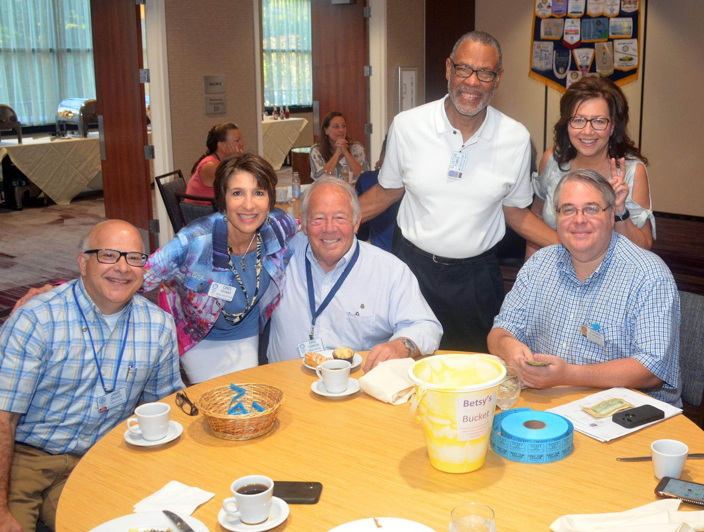
In person, or Virtual!

Slide 54
Is This for Me?
Do you enjoy
working with others to solve problems?
helping those in need?
being part of something larger than yourself?
finding time to help when you thought you had none?

Slide 55
Is This for Me?
Membership Types
Regular
Corporate
Service
Student
Attend most meetings, standard fees
Shared attendance responsibilities
Attend 1 meeting per month, 26 Rotary service hours per year, reduced fees
Attend most meetings, 26 Rotary service hours per year, reduced fees

Slide 56
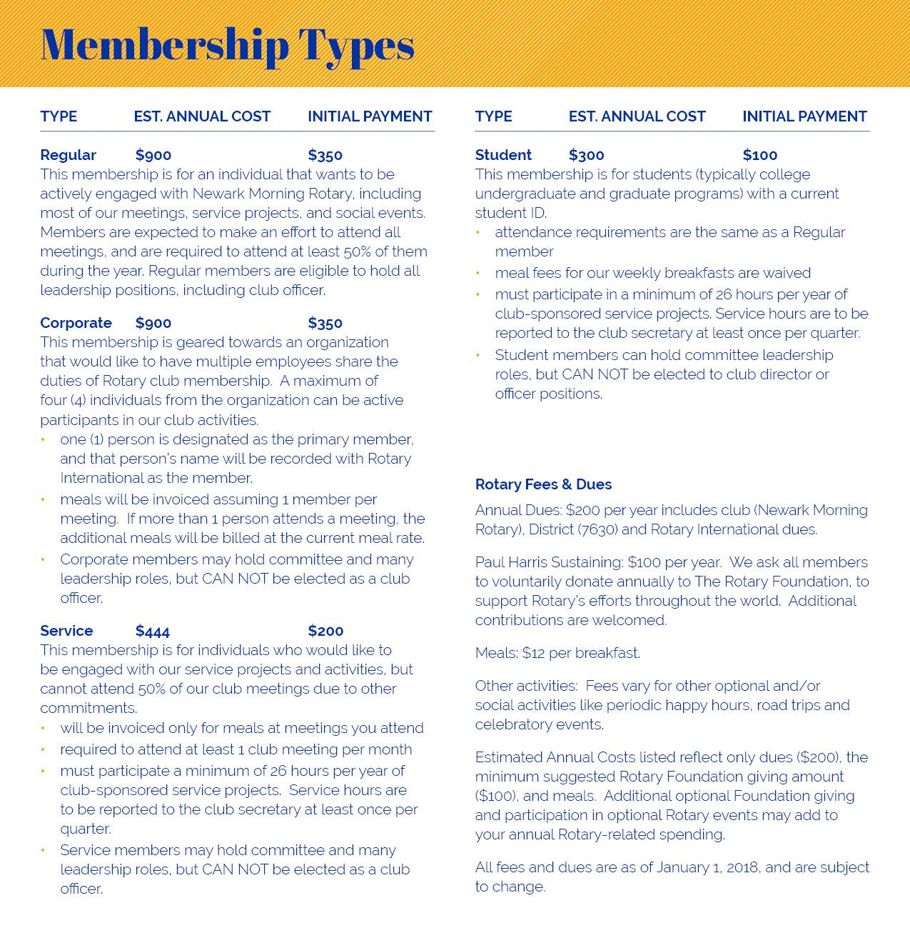
Is This for Me?
What does this cost?

Slide 57
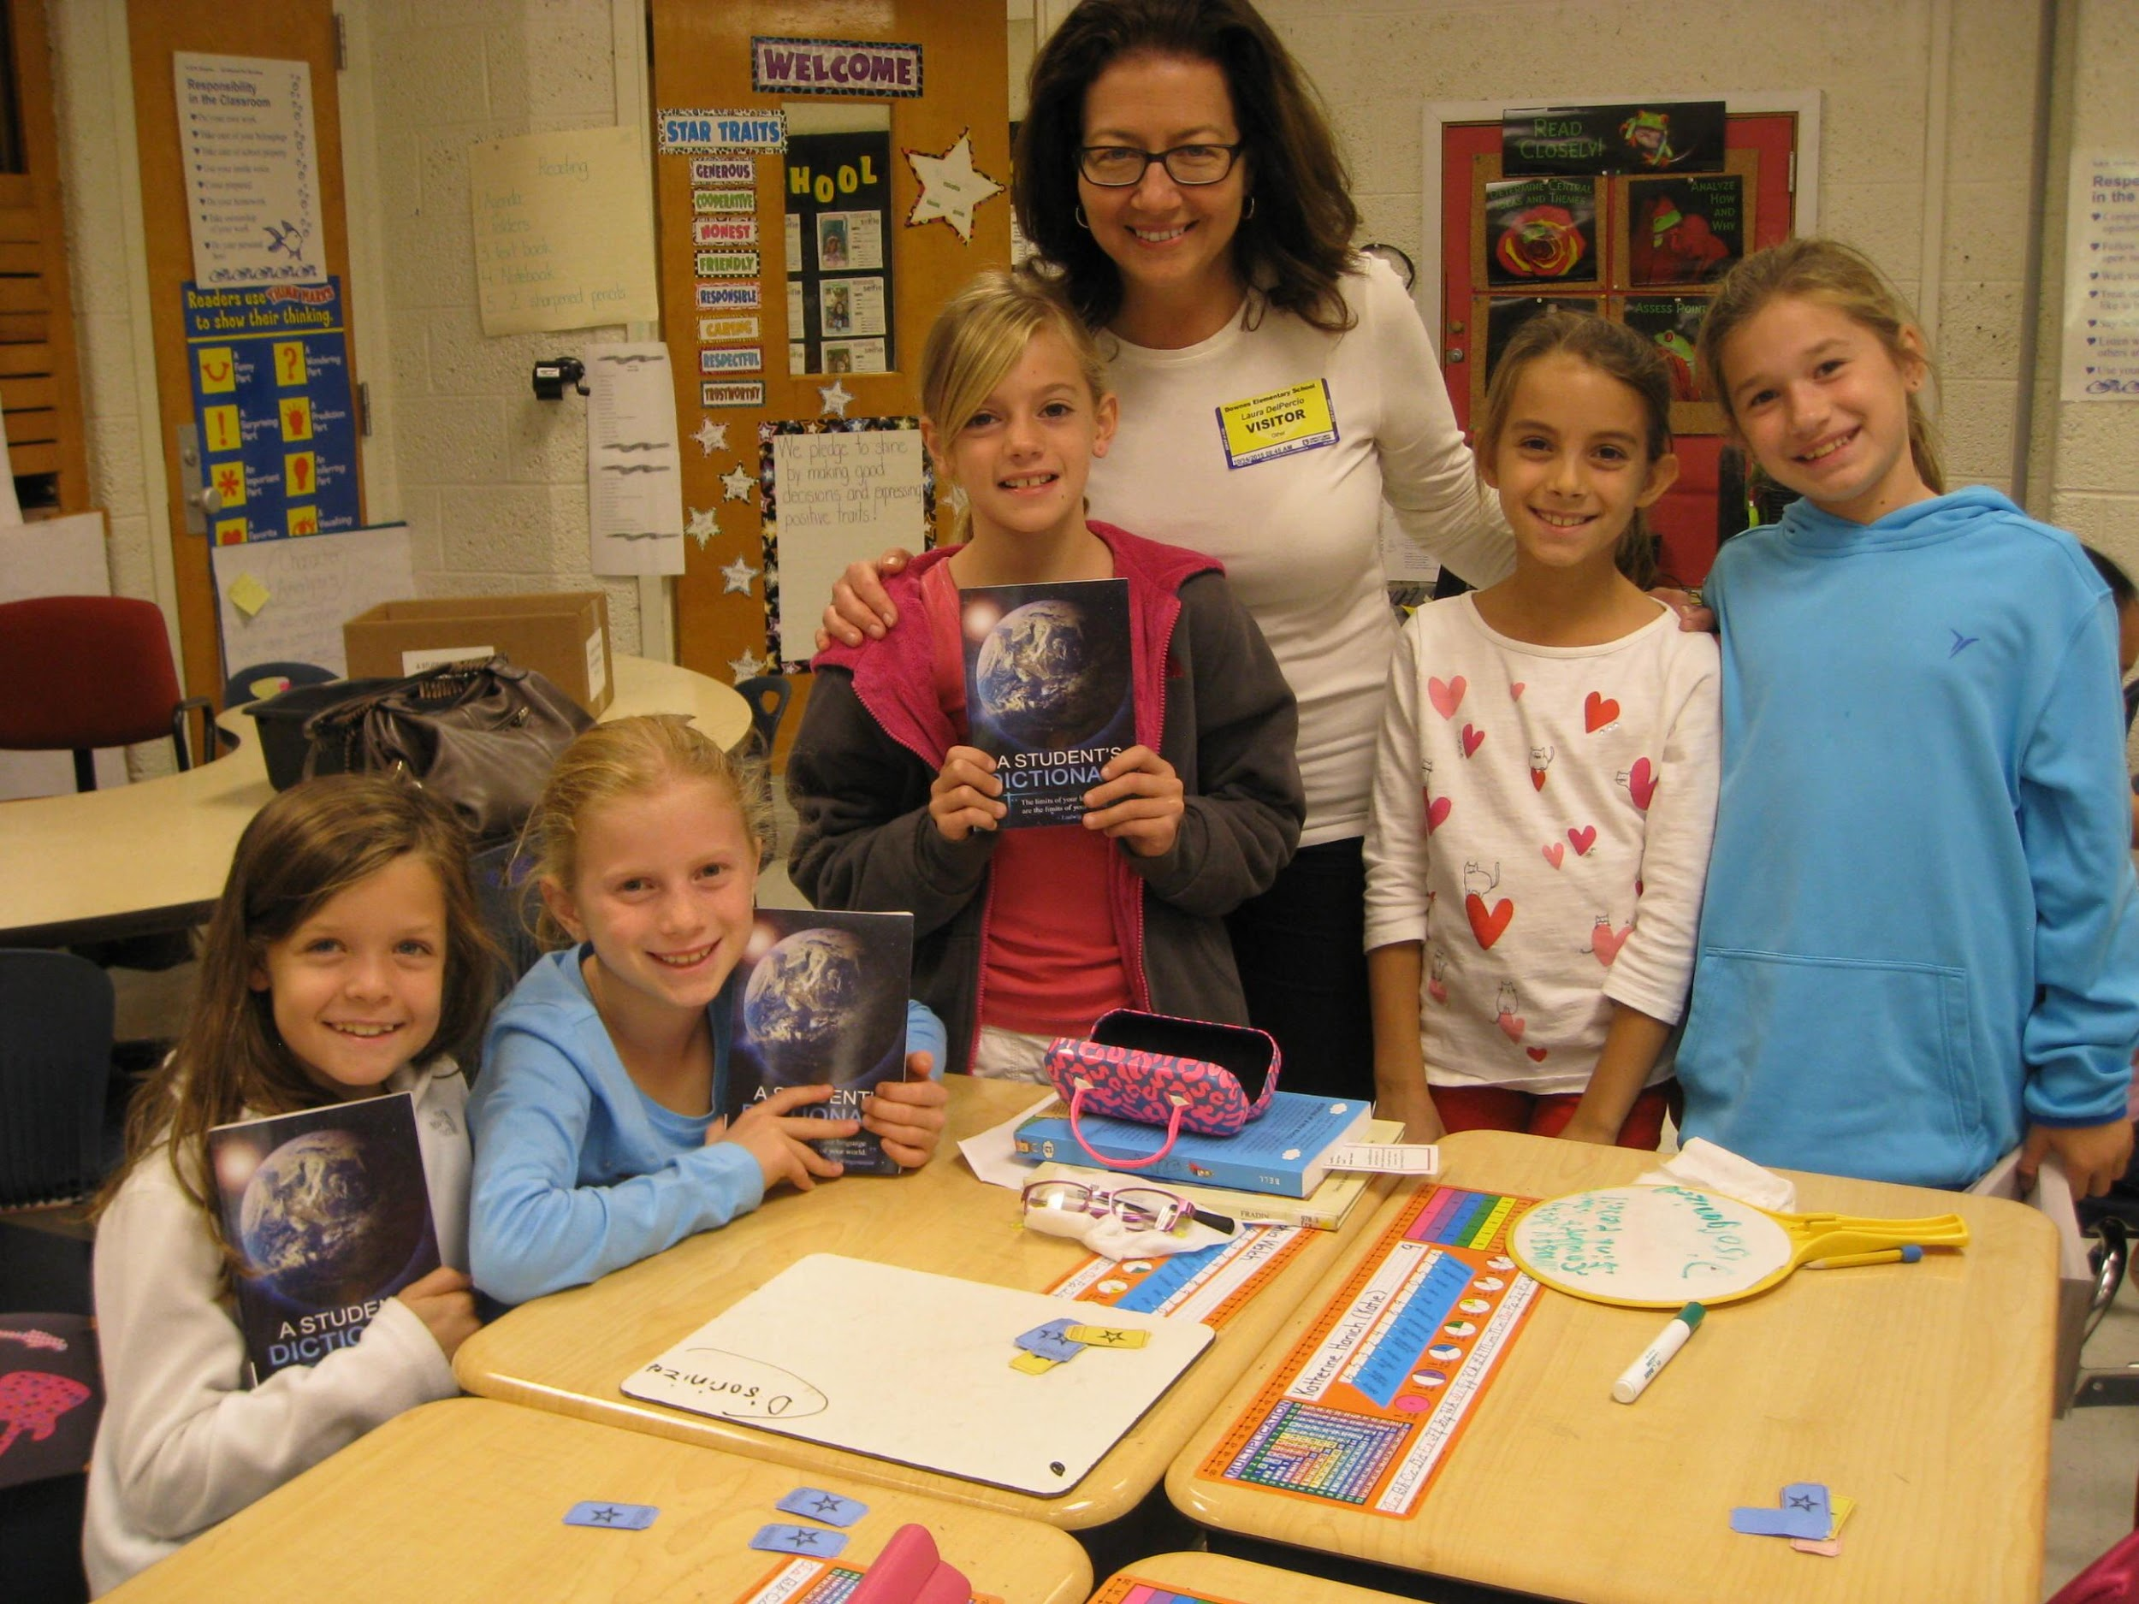
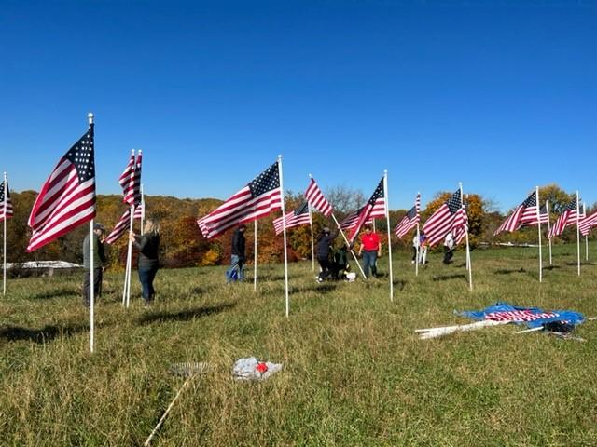
Is This for Me?
Can you see yourself doing this?

Slide 58
Is This for Me?
Why did we become Rotarians?
For the opportunity to help others
For fellowship and fun
To develop professional relationships

Slide 59
Is This for Me?
Is this for you?
Join us for a meeting, and then ...
Answer for Yourself
Notes:
59

Slide 60
Is This for Me?
Questions??

Slide 61
Thank You for Attending!
Newark Morning Rotary
Discover Rotary Hour
September 23, 2023

Slide 62
How to make my club
“Irresistible”

Slide 65
How do I find
prospective members
DGN Dale Kerns
North East Rotary Club

Slide 66
What are the first steps to grow my club?
"Who do You Know?" Club Assembly Exercise
Notes:
Discuss your community’s needs and develop creative ways to meet them
Connect with other leaders who are changing the world
Expand your leadership and professional skills
Catch up with good friends and meet new ones
Get involved in ways that align with your passions, and you’ll get much more from your experience.
Hope is NOT a strategy
Rotary is a “Membership Organization”
Members are our customers
Without members, how will we deliver service?
“Who Do You Know?”
Dedicated club assembly just for this exercise
How many contacts do you have in your Smart Phone?
Now multiply this times all members in your club
How many potential members identified?

Slide 68
How to
Onboard & Involve new members
DGE Randy Smith
ARC Hugh Dawkins

Slide 69
v
Onboarding New Members
New Member Orientation
Onboarding = Critical path item for engagement
Lack of Engagement/belonging = #1 reason for members leaving clubs
Remember that Rotarians join and quit clubs, not Rotary
It’s about the club experience!
See: New Member Onboarding/Orientation Toolbox
New Member Scavenger Hunt
New Member Road Map
Notes:
69
69
Large Banners

Slide 70
Onboarding New Members
Mentorship
A critical link to:
Retention
Engaged Rotarians
Current members attracting new members
Increasing Foundation Support
Increasing use of Public Image
Doing Service!
Notes:
70
70
Large Banners

Slide 71
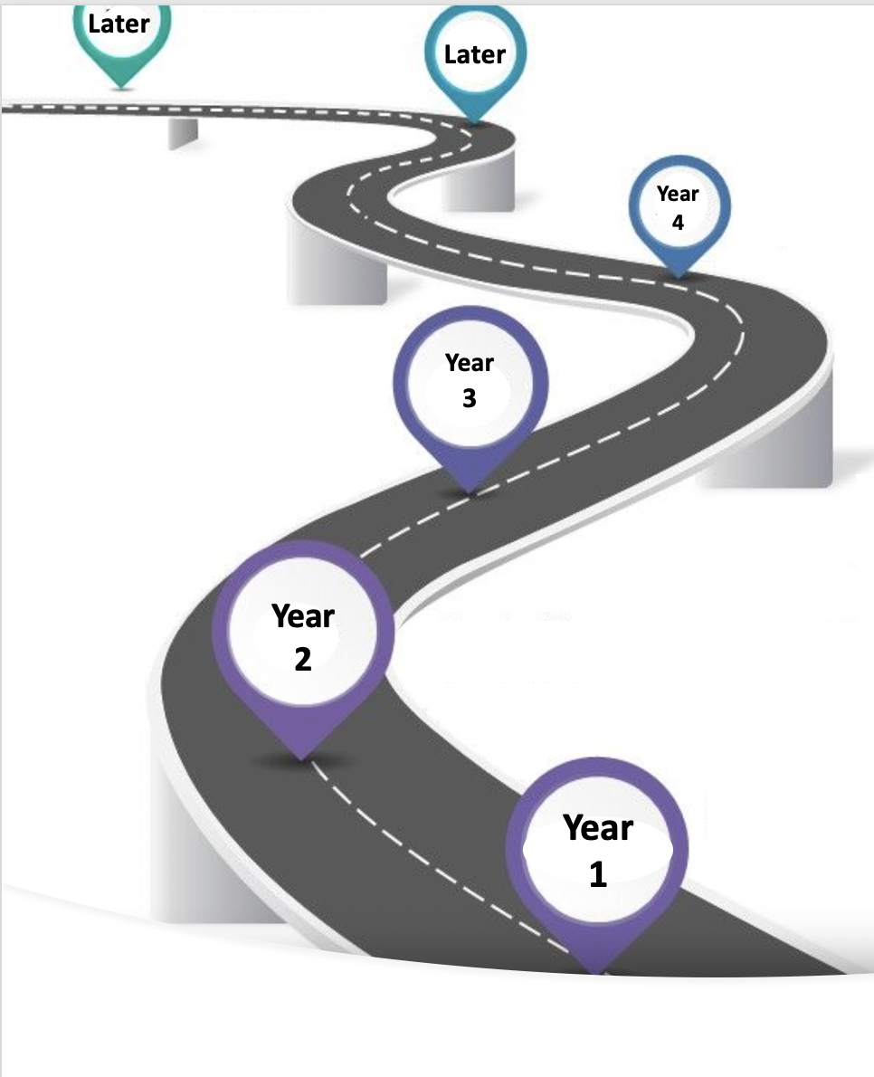
Later
A General Road Map for new Club Members’ Responsibilities
In your 4th year as a Club Member, you may be asked to:
Serve as President-Elect or President Nominee
Oversee a Service Project that you have a passion for
Continue to attract new Members & develop the club
In your 4th year as a Club Member, in addition to 1st year duties, you may be asked to:
Mentor other Rotary members
Provide new ways of energizing/ “livening up” the meeting.
In your 3rd year as a Club Member, you may be asked to:
Serve as a Board Member (attend monthly 1 hour Board meetings).
Serve as Treasurer, Secretary, or President-Elect
Organize and lead a Service Project that you have a passion for.
In your 3rd year as a Club Member, in addition to 1st year duties, you may be asked to:
On occasion, fill in for the President during his/her absence
Help to provide admin support/fill in the gaps as needed
In your 2nd year as a Club Member, you may be asked to:
Serve on a Committee (Membership, Projects)
Asked to lead a project that you have a passion for
Be a Rotary buddy for a new member
In your 2nd year as a Club Member, in addition to 1st year duties, you may be asked to:
Take a more active role in the meetings
Be a Rotary buddy for a new member
Invite prospective members to a meeting, Discover Rotary event or social
Regarding Service Projects, you will be asked to participate as your competing priorities & schedule allows with the following projects:
Beautiful America – trash pick up 1 hour/qtr.
Organize a project – your passion – 1 hour/qtr.
Offer up any service project that touches your heart/ignites your passion & is connected to one of our seven causes: Water & Sanitation, Basic Education & Literacy, Disease Prevention & Treatment, Maternal & Child Health, Peace & Conflict Prevention/Resolution, Economic & Community Development and Protecting the Environment
In your 1st year as a Rotary Club Member, you may be asked to contribute to your Club Meeting by:
Saying an Invocation or Rotary moment
Leading a short song to open the meeting
Gather up “Happy Bucks”
Conduct the 50/50 raffle
Provide a speaker (once or twice in a year
Lead in the Four Way Test of the things we think, say, or do
NOTE: This is only a general guideline. As Rotarians we have busy lives & cannot always follow this path. Your voluntary, engaged membership is what we desire most.
Notes:
One of your Handouts

Slide 73
How to
Retain Members
IPDG Cliff Berg
District MAP Ambassador

Slide 74
Retention of Members

Slide 75
Does Your Club Provide
Mentors
Upgrade the Club Experience
Networking & Social Engagement Opportunities
Meaniingful Service Projects
Membership Satisfaction Surveys
Notes:
Provide a mentor for new members –
Programs need to be informative, educational, or inspirational (or combination thereof) – Don’t be afraid to change things up, social or mini-project
Opportunities to become acquainted, make sure there is intentional outreach to disengaged, as well as engaged
Not just a “check writing club”, Rotary branded projects of your own, hands-on projects
Suggest not using Rotary Health Check (too long) - short & concise – consider surveying new members

Slide 76
Resources
Why Members Leave Handout
August 2023 Rotary Magazine – “Membership Makeover”
Mentor Program Guidelines
Suggested Survey Questions Handout

Slide 77
Retention Is All About Care & Respect For Member!

Slide 79
What is & how to start an
Innovative Club
DICA Chair Pat Campbell-White
ARC Hugh Dawkins

Slide 80
Innovative Clubs: The Low-Hanging Fruit of Membership

Slide 81
Notes:
What are the top two reasons people give, as to why they THINK they can’t join Rotary?
Time
Money
What if moving forward, we designed Rotary to eliminate both of these concerns?
What if time weren’t an issue?
What if money wasn’t a concern?
How can we eliminate both of these elements from the equation?
What is Rotary going to look like if we don’t? If everyone has the right, and should have an opportunity, to be a Rotarian, how else will we ever REALLY Grow Rotary if we don’t look for and make it available to those underserved populations?
That is precisely what we are going to look at today, even if just for a short time.

Slide 82
If we don't start thinking differently, we'll never fill
the empty seats.
Notes:
So here’s where we are <read slide> . . . And there WILL BE empty seats . . .

Slide 83
LIFE HAPPENS
Notes:
Some people cease to be Rotarians for reasons beyond their control, reasons like aging, health, employment that leads to relocation, significant family events . . . There’s not much we can do about those types of things, and we know that they’re going to happen at some point to all of us.

Slide 84
People don't leave Rotary
because they don't like Rotary.
Notes:
But worse yet, some people leave voluntarily . . . Why ?? It’s because they’re not satisfied with their current Rotary experience. There’s nothing wrong for examining what Rotary can do you for you. It’s Service Above Self, but it’s not Service Without Self, and some Clubs lose sight of providing their members with the Rotary they need in order to stay. So while an existing Clubs can sometimes experience a facelift, in some cases, it’s time to create the Club that fits the person . . . create the experience they DO want !! So while improving the existing Clubs is of great importance, so is creating the opportunity for the people whose existing Club structure will for whatever reason not work any more or would never work in the first place.
Are all satellites the same?

Slide 85
How we make an
IMPACT
Meet people where they are
Take the pressure off
Focus on what connects us
Notes:
Here’s what we need to do <read slide>
Does a satellite club have a President? NO, a Chair . . . should be on the parent Club (if any) Board
Can a satellite club have more than one hosting club? NO . . . satellite club members are members of the host club, and you can't be a member of more than one club
Must a satellite club meet weekly/as often as the host? NO . . . RI flexibility allows a club to "meet" as often or not as preferred
Must the satellite club dues be the same as the host? NO . . . all that is required are RI and District dues . . . TRF, meals, etc are TBD by the satellite
Are satellite clubs in competition with the host? NO . . . satellites, particularly Impact as a "companion" club, are designed to support, not compete
Are all satellite clubs the same? NO . . . see above
Are satellite clubs to act without the involvement of the host club after it is formed? YES, with only necessary supervision (we're all in the same club, remember?)
IN FACT, the Impact model offering assistance every step of the way is applicable to the creation of ALL satellite clubs

Slide 86
What is an Innovative
Club?
A Satellite...Sort of
No Meetings
"Satellite" has a negative connotation because of the expectation of breaking away from the host club.
Members have the option of attending meetings, but are not required.
Service Focused
Economical Option
Rotary is a service organization.
When we focus on service, growth is natural.
Finances should never be an obstacle for someone interested in serving in Rotary.
Notes:
Quickly, just as an example, here is what it represents . . .

Slide 87
District Help With starting an Innovative Club
Understanding
your club & goals
Board discussion
& approval
Recruitment
plan & training
RI paperwork & induction planning
Notes:
Here’s the steps you take in creating one . . .

Slide 88
Interested in learning more?
Schedule a Zoom with Innovators to discuss if the INNOVATIVE Companion Club model is right for your club!
patcampbellwhite@gmail.com
Notes:
Here’s how you can learn more about it . . .

Slide 90
TAKEAWAYS
Rotary is a Membership Organization
Service is what we do
Intentional Strategies work - when used
Discover Rotary Hour
Satellite Clubs/Alternate Member Types
Attrition is REAL -- Plan for it!
Notes:
90

Slide 91
TAKEAWAYS
Retention is for the long term
Members don’t quit Rotary; they quit clubs
Membership is within the club’s control
It’s up to ALL OF US to grow Rotary
Notes:
91
Do the Facebook part
Post the selfies to your Page but add hashtags
#RID7630
#Rotary
#----your club’s name

Slide 93
Q & A
DG John Mager

Slide 94
RI Theme 2023-24

